Slide 1


Java Web Search Engine
Presented by:
Group 5
ASE Section 5

Slide 2
Outline
Introduction
Features
Team Roles
Project Flow
Future Scope
Conclusion
References

Slide 3
Team Members and Roles
HTML To Text- Sagar Sharma
Web Crawler-K Kartikeya Rao Pagadala
Page Ranking- Syed Saeed Raazi
Word Search-Dheeraj Gavini
Spell Checker- Lakshika Anand

Slide 4
Introduction
Search engines are web-based software programs that help you find the information you are looking for online using keywords and phrases.
When the user enters a search term, the search engine looks up the page title, content, and keywords of the indexed website and uses an algorithm (step-by-step) to create a list of websites. At the top of the list are the most relevant searches.

Slide 5
Features
Web Crawler
HTML To Text
Word Searching
Spell Checker
Page Ranking

Slide 6
Web Crawler
A Web crawler, sometimes called a spider or spiderbot and often shortened to crawler, is an Internet bot that systematically browses the World Wide Web and that is typically operated by search engines for the purpose of Web indexing (web spidering).
A Web crawler starts with a list of URLs to visit. Those first URLs are called the seeds. As the crawler visits these URLs, by communicating with web servers that respond to those URLs, it identifies all the hyperlinks in the retrieved web pages and adds them to the list of URLs to visit, called the crawl frontier.

Slide 7
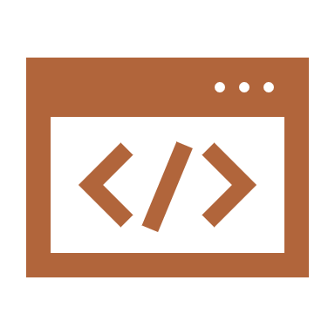
HTML To Text
Here, the parsed data got after the crawling the web will be converted into two types of files
.html
.txt
Files will Stored in two separate Folders
Parsed Data will be passed as parameter into the function will perform the data conversion and storage

Slide 8
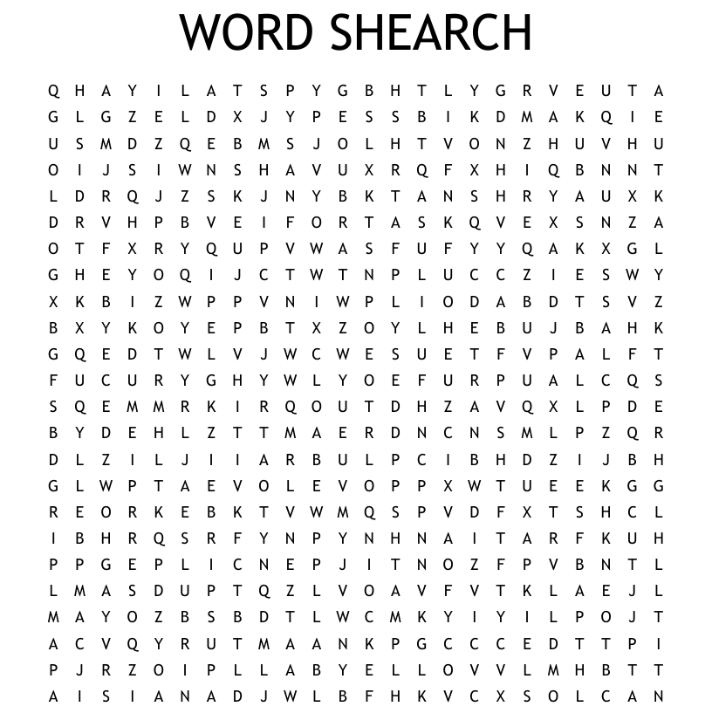
Word Searching
It searches for the words which are entered by the user and displays where exactly the given words are present and the occurrence of the word.

Slide 9
Page Ranking
PageRank is main method of ranking web pages for placement on a search engine results page.
PageRank refers to the system and the algorithmic method that is used to rank pages as well as the numerical value assigned to pages as a score.
Page rank is important because it's one of the factors a search engine like Google takes into account when it decides which results to show at the top of its search engine listings – where they can be easily seen.

Slide 10

Spell Checker
It is a computer program or function (as in a word processor) that identifies possible misspellings in a block of text by comparing the text with a database of accepted spellings

Slide 11
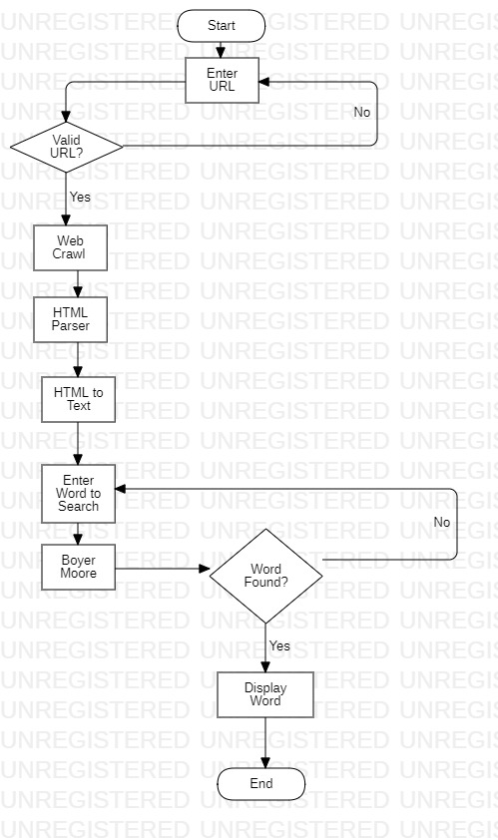
Project Flow

Slide 12
Future Scope
Can use GUI to make it more interactive and easy for everyone to use.
Implement Image Web Search Engine.
We can Implement this in operating systems and make it integrated for Linux platform.
Add User to search for previous history or previous operations to access again.

Slide 13

Conclusion
We have successfully implemented a web search engine and used all the Computing concepts methods and made a web search engine which has features like web crawling, word searching, spell checker and HTML Parsing.

Slide 14

References
ACC Class Slides and Lab Sessions
https://java-source.net/open-source/search-engines
https://www.oracle.com/corporate/features/jsoup-html-parsing-library.html
https://lucene.apache.org/core/3_0_3/api/contrib-spellchecker/org/apache/lucene/search/spell/SpellChecker.html
https://www.javatpoint.com/web-crawler-java
https://www.javacodegeeks.com/2015/09/advanced-java.html

Slide 15
Questions?

